Slide 1
Procedures
Stored

Slide 2
Why use stored procedures ?
Text
Share logic with other applications. Stored procedures encapsulate functionality; this ensures that data access and manipulation are coherent between different applications.
Isolate users from data tables. This gives you the ability to grant access to the stored procedures that manipulate the data but not directly to the tables.
Provide a security mechanism. Considering the prior item, if you can only access the data using the stored procedures defined, no one else can execute a DELETE SQL statement and erase your data.
To improve performance because it reduces network traffic. With a stored procedure, multiple calls can be melded into one.

Slide 3
Picking a Delimiter
Text
The delimiter is the character or string of characters that you'll use to tell the mySQL client that you've finished typing an SQL statement.
For ages, the delimiter has always been a semicolon. That, however, can be changed when required.
In a stored procedure, one can have many statements, and each must end with a semicolon.
This can causes problems, because, the client cannot correctly identify the end of a procedure.
So we can temporarily change the delimiter e.g. “//“ , “$$” etc

Slide 4
Our first procedure
Text
CREATE PROCEDURE `p2` ()
BEGIN
SELECT 'Hello World !';
END

Slide 5
Variables in mysql
Text
Local Variables
Session Variables
Global Variables

Slide 6
defining local variables
Text
Should be defined explicitly at the start of the BEGIN/END block, along with their data types.
Once you've declared a variable, you can use it anywhere within the block.
Declare a variable using the following syntax:
DECLARE varname DATA-TYPE DEFAULT defaultvalue;
Let's declare a few variables:
DECLARE a, b INT DEFAULT 5; DECLARE str VARCHAR(50); DECLARE today TIMESTAMP DEFAULT CURRENT_DATE; DECLARE v1, v2, v3 TINYINT;

Slide 7
define parameters
Text
IN Parameters
OUT Parameters
INOUT Parameters

Slide 8
Flow Control Structures
Text
Flow control structures are the heart of any programming language
These constructs help us to add application logic in MySQL
MySQL supports the IF, CASE, LOOP, WHILE and REPEAT constructs for flow control within stored programs.

Slide 9
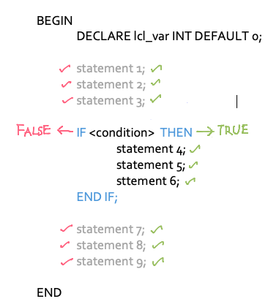
a. The ‘if’ statement
With the IF statement, we can handle tasks which involves conditions
We can perform specific tasks based on certain conditions
IF <condition> THEN
statements
END IF;
II

Slide 10
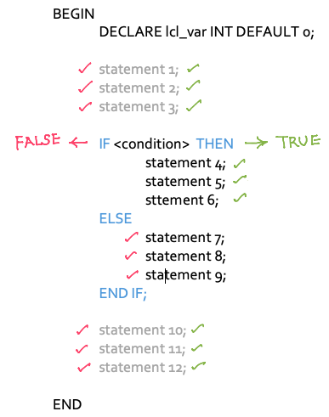
If - else statement
IF <condition> THEN
statements
ELSE
statements
END IF;

Slide 11
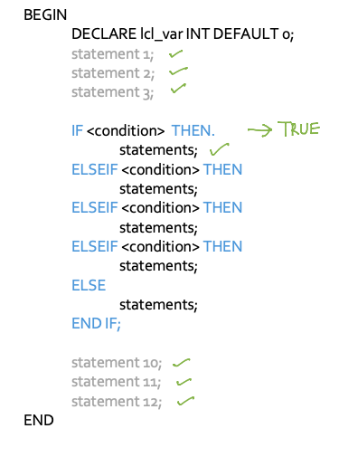
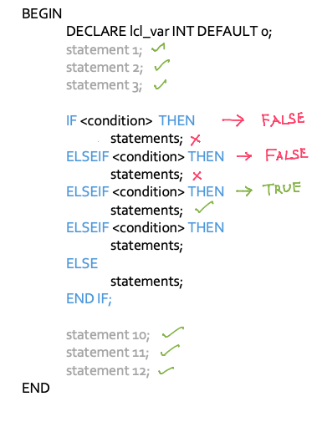
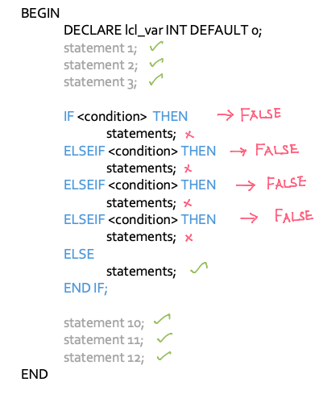
If - elseif - else

Slide 12
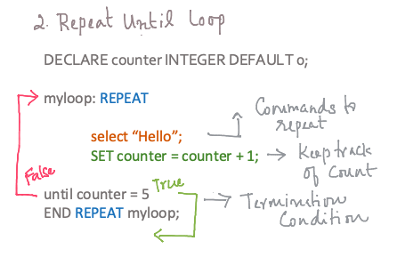
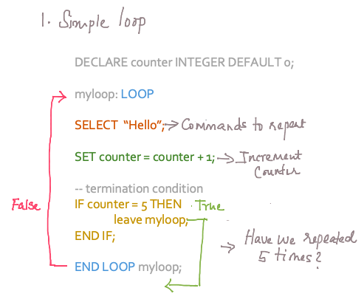
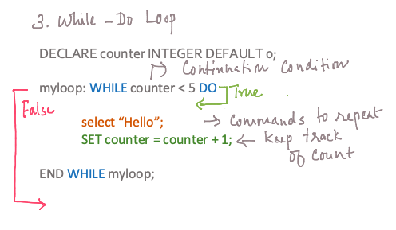
Loops

Slide 13
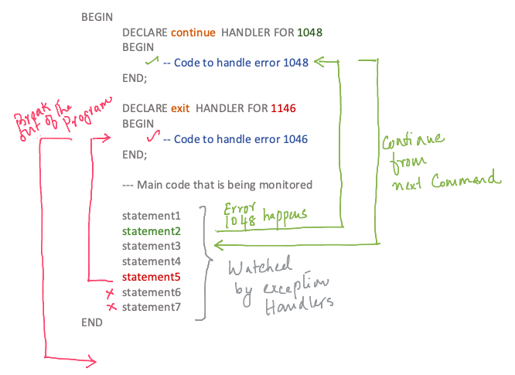
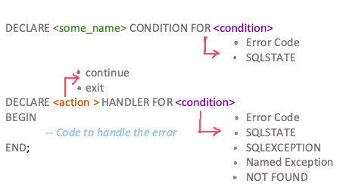
Exception Handling

Slide 14
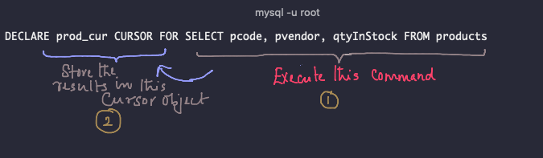
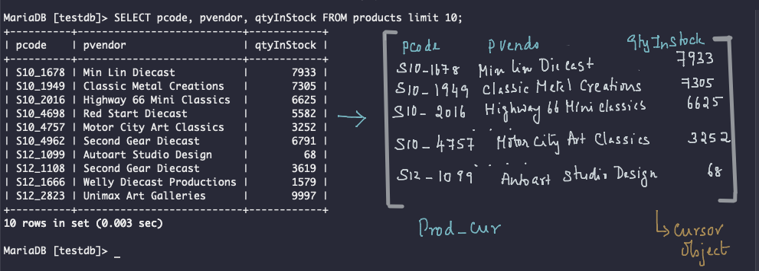
Step 1 Declare the cursor

Slide 15
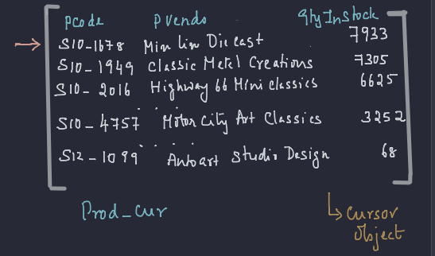
Step 2 Open cursor
Text

Slide 16
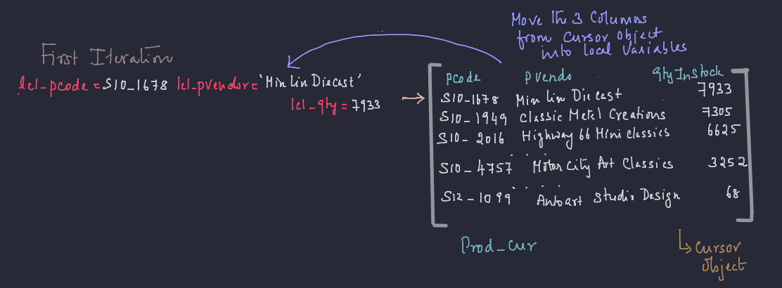
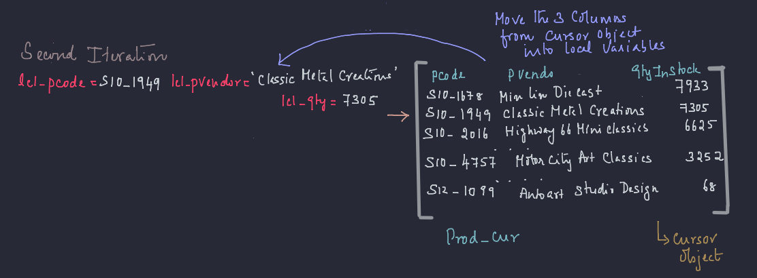
Step 3 fetch the cursor

Slide 17
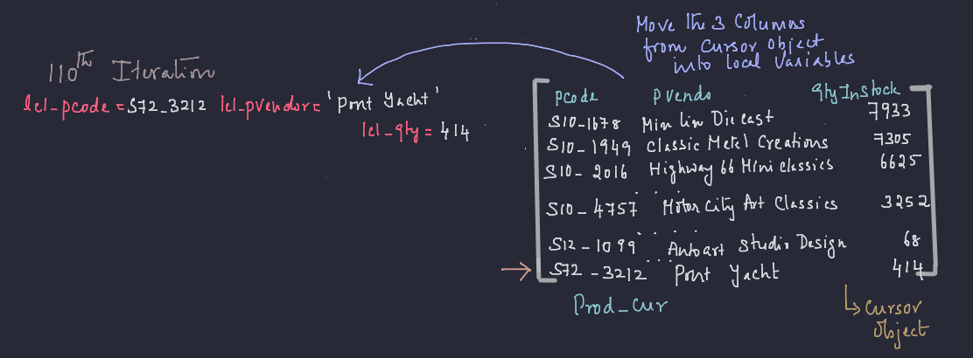
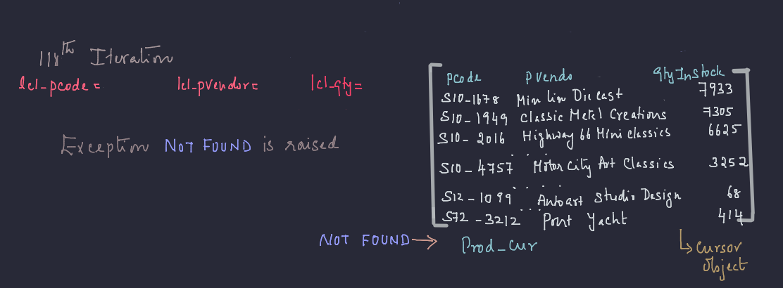
Not found exception

Slide 18
Steps for handling cursors
Recap
DECLARE cursor-name CURSOR FOR SELECT ...;
DECLARE CONTINUE HANDLER FOR NOT FOUND
OPEN cursor-name;
FETCH cursor-name INTO variable [, variable];
CLOSE cursor-name;

Slide 19
properties of cursors
Text
Cursor has three important properties that we need to be familiar with in order to avoid unexpected results:
Asensitive : Once open, the cursor will not reflect changes in its source tables. In fact, MySQL does not guarantee the cursor will be updated, so you can't rely on it.
Read Only : Cursors are not updatable.
Not Scrollable : Cursors can be traversed only in one direction, forward, and you can't skip records from fetching.

